Slide 1
Investigating the suitability of Machine Learning agents to replace traditional AI and playtest game levels

Slide 2
Motivation
“The first part of debugging is exciting; it's the first feedback. Somebody is actually playing your game. But by the end, you get sick of the little problems. You have spent three months inventing the game, and now you have to spend just as much time cleaning it up.” – Steve Meretzky, 1984
What is the problem?
Beyond existing work
It’s not easy to find someone to playtest
a game with you
Little evidence of AI agents being used in playtesting
Human playtesting takes a lot of time
Notes:
Why is the project worth doing? What is the problem it is trying to solve? Which need is being addressed?
This should clearly motivate the project in terms of which specific need it addresses, what problem it solves and who will benefit from it.
An “upper second” section of this type would also identify specific points where the proposed project will go beyond existing work and discuss the reasons why this is desirable. You can include some personal motivation (why this project is attractive to you) but focus on the wider benefits.

Slide 3
Motivation
Machine learning is already used in video games… Why are we still using traditional AI NPCs?
What is the problem?
Beyond existing work
Traditional AI is almost as old as video games themselves
One of the first attempts (that I’m aware of) to train models that, if suitable, can be used freely by everyone
Traditional AI takes a lot of time to code
Lack of pre-trained models available for use online

Slide 4
Aims
To train two Artificial Intelligence agent models – a hider and a seeker – and test their suitability to replace traditional AI and human players in game level playtesting.
Notes:
What will the project try to accomplish? Which key objectives will need to be achieved in order to realise the overall aim or prove/disprove your hypothesis?
This should be a list of bullet points concisely and precisely identifying the overall aim or hypothesis and resulting objectives of the project. Objectives can include both technical and (at most two) personal objectives, and if all achieved, should result in the overall aim being realised.

Slide 5
Objectives
Build an understanding of how Machine Learning works.
Understand how to use Unity’s ML-Agents toolkit by training an example model.
Build an traditional AI agent that patrols a level and chases the player if he is seen.
Train a hider agent that achieves a high win rate against a traditional non-ML AI agent.
Train a seeker agent that accurately mimics the behaviour of a traditional AI.
Evaluate the seeker agent against the traditional AI by some measure.
7. Evaluate the hider agent by comparing its performance to real human players.
Notes:
What will the project try to accomplish? Which key objectives will need to be achieved in order to realise the overall aim or prove/disprove your hypothesis?
An “upper second” section of this type will define objectives fully and sensibly, identifying success criteria that are measurable as well as clearly linking objectives to the overall aim and the project. Ideally your objectives should be “SMART”, although it is not essential that all of them are. Avoid listing tasks but focus on what you want to achieve. For example, instead of saying that you will “research into X”, state that you will “identify six main attributes of X from the literature” (if that is a desirable outcome of the research). Your objectives will form the criteria for success for your project. It is therefore essential that you can measure the extent to which you have satisfied them. If your objectives are clear and measurable then you will be able to scope and focus your project and it will make your evaluation much easier to define. In contrast a poorly defined aim and objectives often lead to a poor project outcome.

Slide 6
Background
The citation | Summary | Relevancy to the project
https://github.com/Unity-Technologies/ml-agents/tree/master/docs | The documentation for Unity’s ML-Agents toolkit. | The documentation will help me answer any questions I have about the toolkit.
https://towardsdatascience.com/an-introduction-to-unity-ml-agents-6238452fcf4c | A free Unity ML-Agents course with several tutorial projects to follow. | These example projects will help me learn how to use ML-Agents and to start training my own models.
https://www.elementsofai.com | The Elements of AI is a series of free online courses. | This is a great beginner-friendly introduction to AI as well as building AI.
https://openai.com/blog/emergent-tool-use/ | OpenAI’s paper on multi-agent interaction | This paper inspired my project.
Notes:
a table summarising key background sources and identifying their relationship to the project at hand
This should be a table summarising the key sources that have been identified so far. Each entry in the table should consist of three elements: a citation of the source (which will be included in detail in the list of references), a sentence or two summarising the source, and a brief explanation why this source is relevant to the project.
An “upper second” background section should contain a sufficient number of sources from all areas relevant to the project, provide summaries for each that clearly state the key point of the source, and a concise explanation of how it is relevant in the context of the project. Do not include so many sources that you must reduce content to fit them in. A general guideline would be at least 4 but no more than 8. The emphasis should be on the quality of explanation, not the quantity of sources.

Slide 7
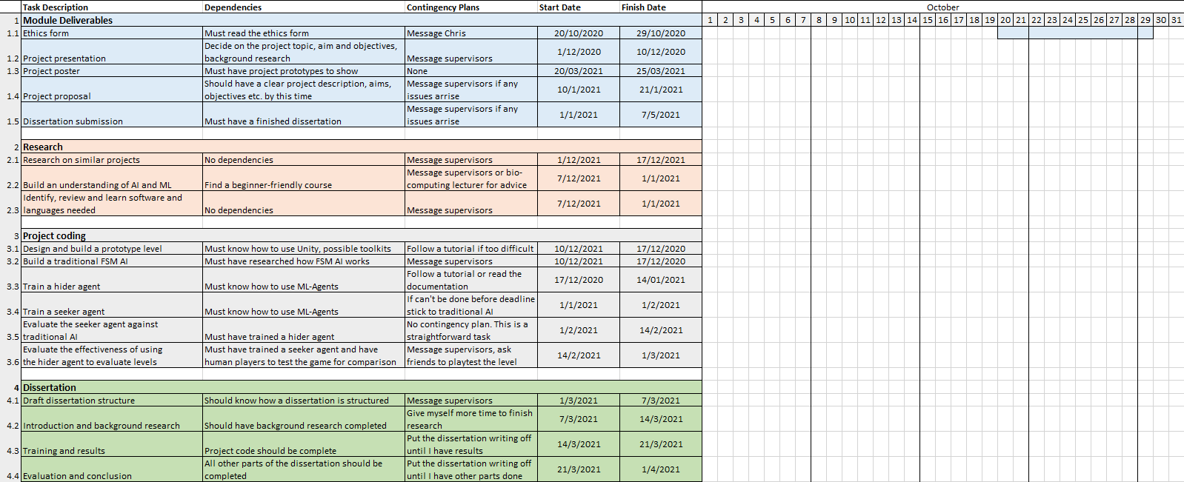
Timeline, work plan
Notes:
a diagram (e.g. Gantt chart, timeline) detailing how the project will be carried out, e.g. which activities/tasks will be carried out when
This should provide a detailed overview of how the project has been and will be carried out. The plan is there to help you and your supervisor structure your project and track your progress. It therefore needs to include sufficient detail to identify activities at a weekly to bi-weekly level, so that at any point in time it should be possible to identify what you should be doing and what you should have achieved. It should include a breakdown of tasks to be completed that are well specified in terms of their estimated starting/end time as well as the effort expected to carry them out.
An “upper second” plan will identify relationships and dependencies between individual tasks and incorporate contingency measures. Make sure that the plan is clearly legible, and that deadlines and task durations are clearly displayed.

Slide 8
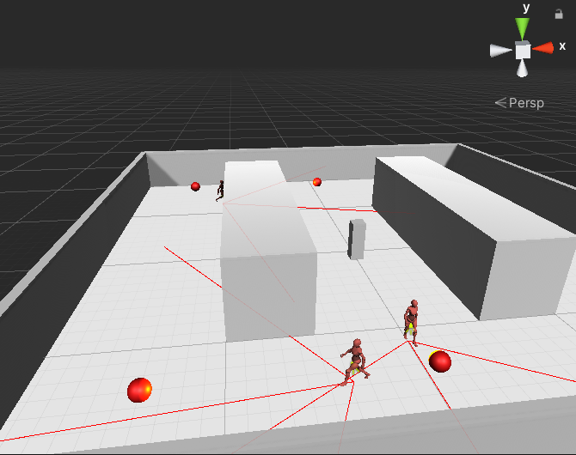
Work so far and risks
Identified software and tools
Created a simple level prototype
Researched and coded simple FSM AI
Risks
No experience with Machine Learning
Gathering enough human playtest data
Notes:
What has been done so far? Why is the plan structured as it is?
An “upper second” explanation will clearly link the work plan to the objectives, identify risks associated with key tasks and outline contingency measures included in the plan.

Slide 9
Summary
My goal is to train ML agents to assist in level playtesting and evaluation.
A clear work plan and contintengy plans have been defined.
Already have prototypes.

Slide 10
References
1. Unity-Technologies. 2017. Unity ML-Agents Toolkit. [online] Available at: <https://github.com/Unity-Technologies/ml-agents/tree/master/docs> [Accessed 7 December 2020].
2. Simonini, T., 2020. An Introduction To Unity ML-Agents. [online] towardsdatascience. Available at: <https://towardsdatascience.com/an-introduction-to-unity-ml-agents-6238452fcf4c> [Accessed 7 December 2020].
3. elementsofai. 2020. A Free Online Introduction To Artificial Intelligence For Non-Experts. [online] Available at: <https://www.elementsofai.com> [Accessed 7 December 2020].
4. Baker, B., Kanitscheider, I., Markov, T., Wu, Y., Powell, G., McGrew, B. and Mordatch, I., 2020. Emergent Tool Use From Multi-Agent Interaction. [online] OpenAI. Available at: <https://openai.com/blog/emergent-tool-use/> [Accessed 7 December 2020].
Notes:
References and citations should consistently follow one of the standard schemes and include all relevant bibliographical information. The list of references has to include all sources discussed in the background section. The proposal itself should be a pleasure to read, nicely presented, well-structured with very few spelling mistakes or grammar mistakes, proper use of figures, etc. The document should make appropriate use of whitespace, have consistent margins (at least 2cm) and avoid cluttering. The text should be 11pt throughout (incl. within diagrams and tables) and the document should not run to more than 4 pages plus references.

